Slide 1

STUDENT DROPOUT PREDICTION
BY GEORGE SYLVA

Slide 2

OUTLINE
Introduction
Methodology
Results/fiindings
conclusion

Slide 3
Introduction
Problem Statement: Universities and educational institutions face challenges in retaining students, with dropout rates affecting both student success and institutional reputation. Identifying students at risk of dropping out can help in taking timely interventions and improving retention.
Objective: The goal of this project is to develop a machine learning model that can accurately predict student dropout based on academic performance, demographic factors, and other key variables. This will enable educators and administrators to focus on students who are more likely to drop out and provide them with necessary support.

Slide 4
I analyzed student data, including both categorical and numerical features, such as "Course," "Mother’s Occupation," "Previous Qualification (Grade)," "Admission Grade," "Curricular Units Enrolled" etc
The initial dataset has 4424 rows and 37 columns
A Random Forest model was then trained and evaluated using selected features of this data to predict the likelihood of a student dropping out.

Slide 5
Methodology DATA PREPROCESSING
The features which included numerical and catgorical features had to be ran through a pipeline for preprocessing. The target was seperated during train-test-split and label encoded.
The numerical features were scaled using Standard_scaler (-1 to 1)
The categorical features all seem not to need any transoformal since all categorical features appear to be encoded altight.
Knn imputer was used to handle any missing numerical value, of which there was none but this will come in handy when pipeline Is used in model building and deployed. Missing values will not necessarily affect model because knn is handling it.

Slide 6
Feature selection
Problem: Not all features contribute equally to predicting the target variable (Dropout/Graduate/Enrolled).
Solution:
We applied Recursive Feature Elimination (RFE) using the Random Forest model to select the most important features.
RFE iteratively removes the least important features to identify the subset that maximizes model performance.
I used RFE of various number of key features and when feature was 15 model performance was close enough to its performance when we used all 36 training features.

Slide 7
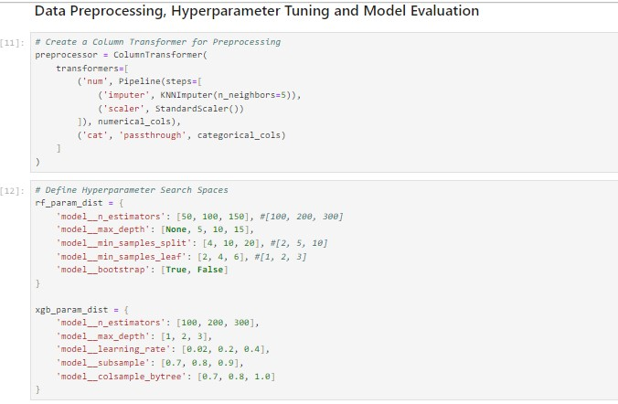
The passthrough method was used for the categorical columns since we will not be transforming those

Slide 8
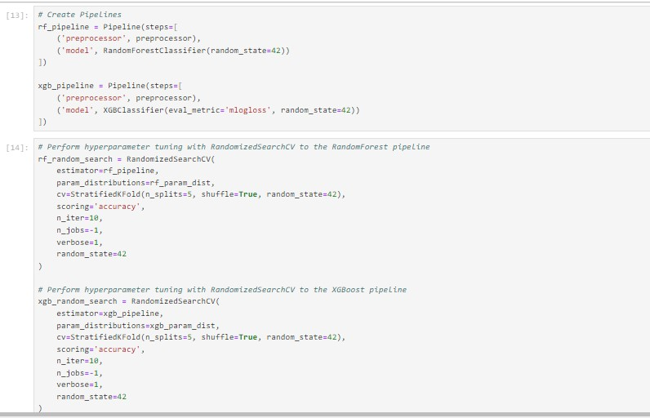
Pipelines for rf model and xgboost and hyperparameter tuning using pipelines

Slide 9
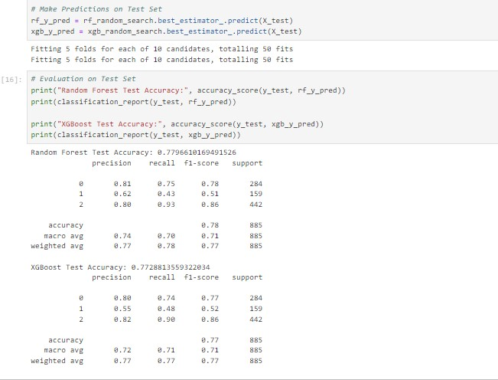
Models performances after using hyperparametr tuning

Slide 10
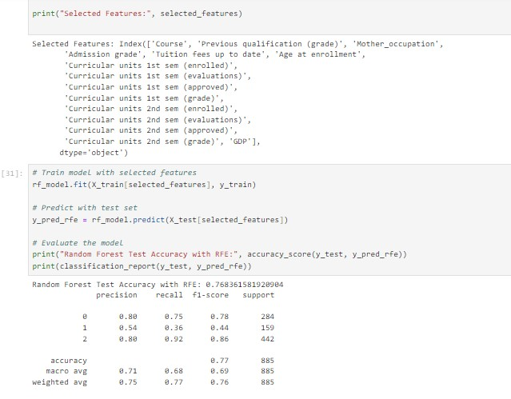
During feature selection it was discovered that the best performance was when number of feature was 15. These were then used to train our model

Slide 11
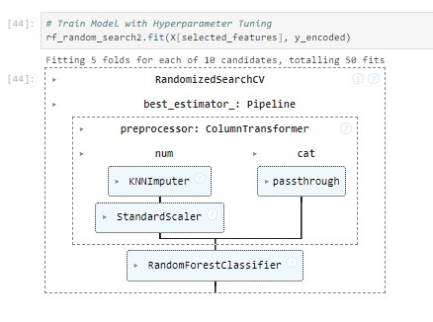
Flow chart of our rf model using its best estimator. Within the pipeline is our preprocessor for both numerical and categorical features.

Slide 12
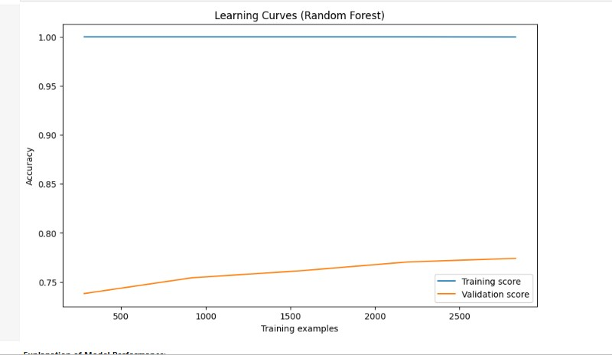
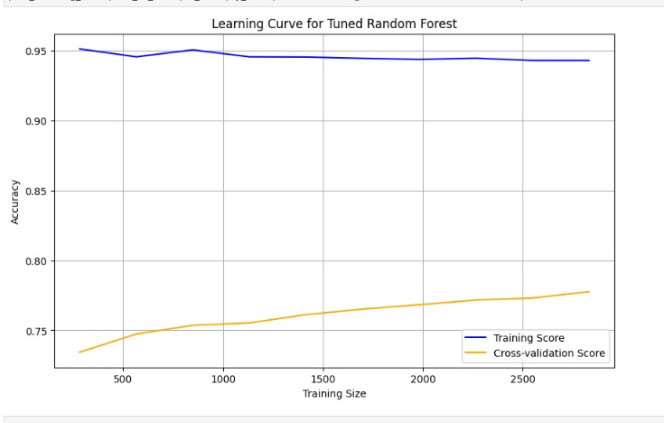
RF model evaluation plot

Slide 13
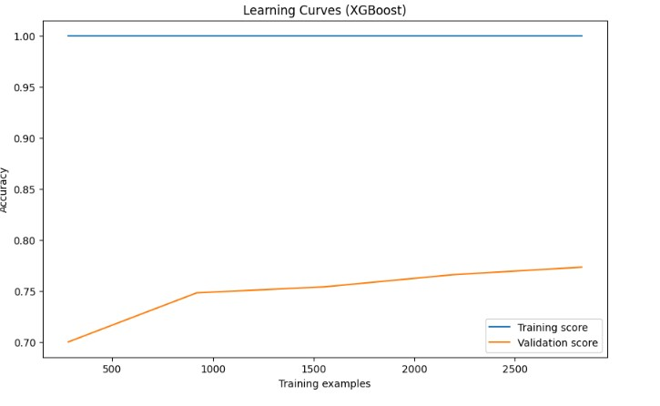
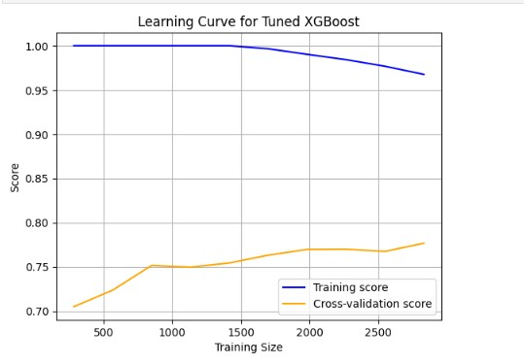
xgboost model evaluation plot

Slide 14
Model deployemnt student dropout prediction app
After training and fine-tuning the machine learning model, the next step was deploying it for practical use. In this project, we deployed the trained Random Forest model in the form of a web application using Streamlit. The app allows users to interact with the model and make predictions based on student data, helping to forecast the likelihood of student dropout or graduation.
After tuning the Random Forest model, it was saved as a serialized object using Joblib. Along with the model. the Label Encoder used to transform the target variable into numeric labels was also saved.
Reason: Saving the model and encoder ensures that we can easily reload them in the deployment environment for making predictions without retraining.

Slide 15
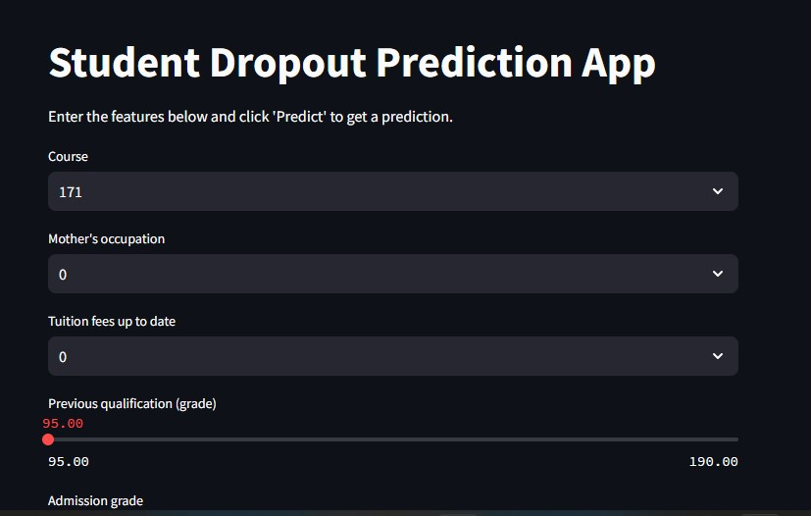
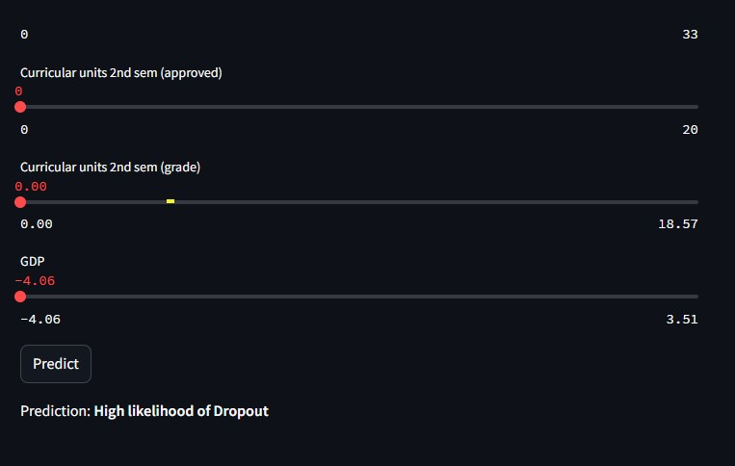
Streamlit app

Slide 16
conclusion
In this project, we successfully built a machine learning pipeline to predict student outcomes, with a focus on identifying students at risk of dropping out. We started with thorough data analysis and preprocessing, followed by training a robust Random Forest model, which performed well in predicting the likelihood of dropout, enrollment, or graduation. The model was then deployed in an easy-to-use Streamlit web application.

Slide 17
Key Takeaways:
Data Insights: Through data exploration, we identified key factors influencing student performance and dropout risk, such as previous academic performance, family background which is reflected in parents occupation and how updated childs tuition fee payments is.
Model Performance: Our Random Forest model provided high accuracy in predicting student outcomes, thanks to careful feature selection, hyperparameter tuning, and robust cross-validation techniques.
App Deployment: The interactive Streamlit app makes the model accessible to stakeholders, allowing educators and administrators to input student data and quickly predict their risk of dropout.

Slide 18
reference
GitHub Repo: https://github.com/georgesylva1/3signet_task_1
Streamlit app: https://3signettask1-version3.streamlit.app/

